Slide 1
6/23/20
ET 8402: Mobile Communication
CoICT – ETE

Slide 2
6/23/20
Course Outline
Evolution of Mobile Communication Systems
Cellular Concept and architecture
Mobile Cellular Architectures
Mobile Radio Propagation
Radio Spectrum as a Scarce Resource
Mobile Radio Modulation Technique
Multiple Access Techniques
CoICT – ETE
References
Theodore S. Rappaport, Wireless communications: Principles &Practice , 2002
Andrea Goldsmith, ―Wireless Communications, 2005
David Tse, ―Fundamentals of Wireless Communication,
2005.
CoICT – ETE

Slide 3
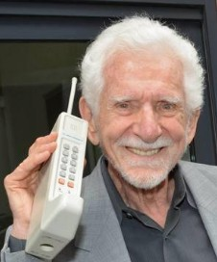
6/23/20
Evolution of Mobile Communication
Mobile communication uses technology that allows us to communicate with others in different locations without the use of cables. It facilitates Mobility
Types of mobile communication systems include:
Mobile two-way radio, public land
Mobile telephone
Amateur (HAM) radio
CoICT – ETE
University of Dar es Salaam
Invention of First Mobile Phone
American engineer at Motorola
Born in1928
1972–73 built the first mobile cell phone
Initially developed to use in a car, the
first prototype was tested in 1974.
He is widely regarded as the father of the cellular phone
Martin Cooper
CoICT – ETE

Slide 4
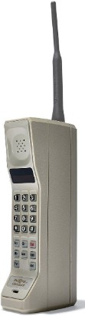
6/23/20
Evolution of Mobile Communication….
Mobile wireless communication system has gone through several evolution stages
The evolution was inevitable due to huge demand for more connections worldwide and better performance.
Therefore mobile communication standards advanced rapidly to support more users with better services
The different generations and evolutions in wireless mobile telecommunication technology and 1G, 2G, 3G, etc
CoICT – ETE
University of Dar es Salaam
First Generation, 1G
This is the first generation of mobile phone
Deployed in Japan by Nippon Telephone and Telegraph company (NTT) in 1979
In the beginning of 1980s, it gained popularity in
the US, Finland, UK and Europe.
CoICT – ETE

Slide 5
6/23/20
1G Features
Frequency 800 MHz and 900 MHz
Technology: Analogue switching
Mode of service: voice only
Access technique: Frequency Division Multiple Access
(FDMA)
It allows the voice calls in one country
Bandwidth: Analog telecommunication (30kHz)
CoICT – ETE
1G Popular Systems During 1980’s
Advanced Mobile Phone System (AMPS)
Nordic Mobile Phone System (NMTS)
Total Access Communication System (TACS)
European Total Access Communication System (ETACS)
CoICT – ETE

Slide 6
University of Dar es Salaam
6/23/20
1G Popular Systems During 1980’s
Advanced Mobile Phone System (AMPS)
It was the primary analog mobile phone system in North America in 1983
Israel in 1986, Australia in 1987, Singapore in 1988, and
Pakistan in 1990
CoICT – ETE
1G Popular Systems During 1980’s
Nordic Mobile Telephone (NMT, NMT-450, and NMT- 900)
Originally designed for and by Nordic countries (Finland, Sweden, Norway, Denmark)
Widely deployed around the world, for example in Saudi Arabia, Russia and Switzerland.
CoICT – ETE

Slide 7
6/23/20
1G Popular Systems During 1980’s
Total Access Communication System (TACS)
and European TACS (ETACS) are mostly-obsolete variants of Advanced Mobile Phone System (AMPS)
Announced as the choice for the first two UK national
cellular systems in 1983
CoICT – ETE
1G Systems Disadvantages
Poor voice quality due to interference
Poor battery life
Large sized mobile phones (not convenient to carry)
Less security (calls could be decoded using an FM
demodulator)
Limited number of users and cell coverage
Poor handoff reliability
Roaming was not possible between similar systems
CoICT – ETE

Slide 8
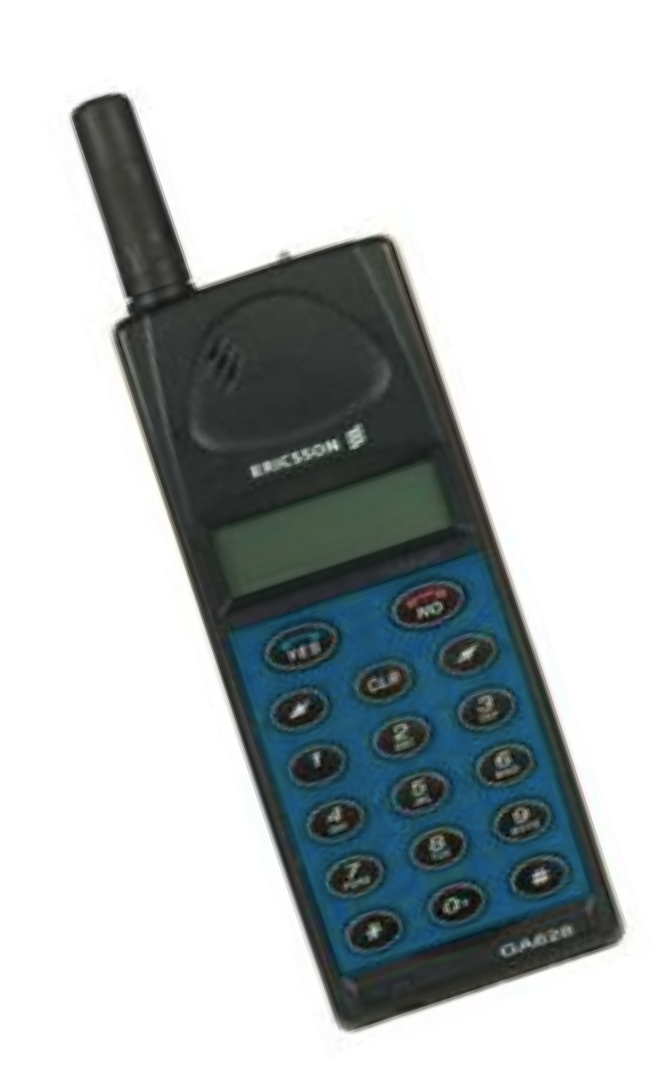



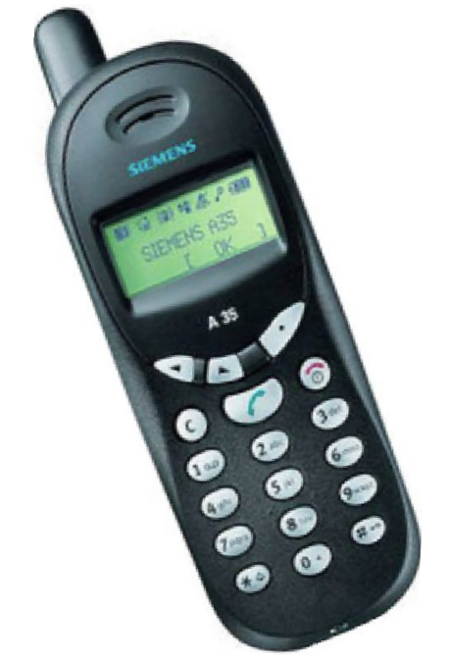

6/23/20
Second Generation 2G
Was launched in Finland in 1991
Is a new digital technology for wireless transmission
It was known as Digital Era
Based on Global System for Mobile communication (GSM) technology
GSM was globally accepted
Also CDMA technology is used
CoICT – ETE
2G Features
Digital system
supporting up to 64kbps data rate
Frequency: 900/1800 MHz
Access: Time Division Multiple Access (TDMA)
Text and multimedia messaging services
Roaming is possible
Enhanced security
Encrypted voice transmission
CoICT – ETE

Slide 9
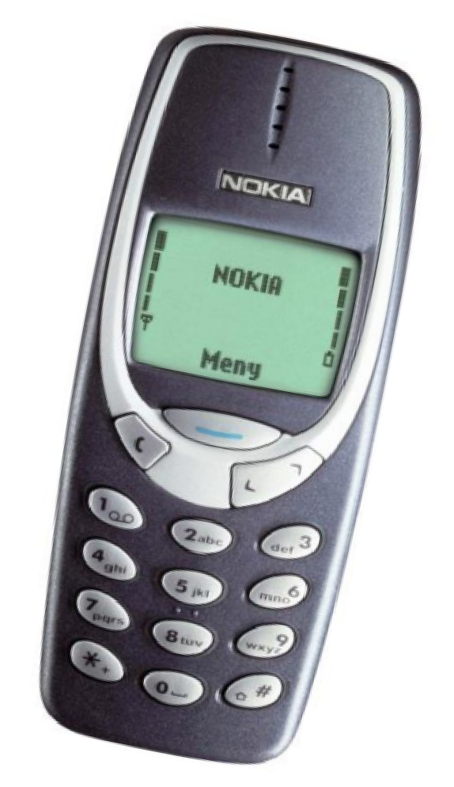



6/23/20
2G System Disadvantages
Low data rate
Limited mobility
Less features on mobile devices
Limited number of users and hardware capability
Unable to handle complex data such as Video
CoICT – ETE
Second and a Half Generation, 2.5G
Is a 2G system combined with General Packet Radio Services (GPRS) to provide higher data rate and additional capabilities
2.5G is used to describe 2G systems that have
implemented a packet-switched domain
in addition to the circuit-switched domain
2G + GPRS
Speed 56 – 64kbps
CoICT – ETE

Slide 10
University of Dar es Salaam
6/23/20
2.75 Generation
In order to enhance Data rate GPRS networks evolved to Enhanced Data rates for GSM Evolution (EDGE) networks
Also known as Enhanced GPRS (EGPRS)
Data rate 170 kbps
EDGE is considered a pre-3G radio technology and is part of ITU's 3G definition
Also standardized also by 3GPP as part of the GSM family
CoICT – ETE
University of Dar es Salaam
2.75 Generation
Implemented as a enhancement for 2.5G GSM/GPRS networks, making it easier for existing GSM carriers to upgrade to it
EDGE requires no hardware or software changes to be
made in GSM core networks.
EDGE-compatible transceiver units must be installed and the base station subsystem needs to be upgraded to support EDGE
CoICT – ETE

Slide 11
6/23/20
3rd Generation Project Partnership (3GPP)
3GPP is a consortium with national or regional telecommunication standards organizations
Established in December 1998
It goal was to develop a specification for a 3G mobile
phone system based on the 2G GSM system
CoICT – ETE
Third Generation 3G
Introduced in early 2000s
Uses Universal Mobile Terrestrial System (UMTS)
Data rate 384 kbps
Uses of packet switching for data transmission.
High speed web or more security
Video conferencing, 3D gaming, TV streaming, Mobile TV, Video calls, etc. Know as smart phones
Uses WideBand-Code Division Multiple Access (W-CDMA)
CoICT – ETE

Slide 12
6/23/20
3.5G and 3.75G
Also know as 3G+ or Turbo 3G
There was need improve the performance of 3G UMTS based system
High-Speed Packet Access (HSPA) technology was
introduced and hence 3.5G
A further improved resulted into Evolved High Speed Packet Access also known as HSPA+ which is 3.75G
Bit-rates as high as 337 Mbps downlink and 34 Mbps uplink
CoICT – ETE
3.95G
This project is known as Long Term Evolution (LTE)
Uses Orthogonal Frequency-Division Multiplexing Access (OF-DMA)
Long Term Evolution in preparation to achieve 4G
Also known as 4G LTE
Offers data rate at 170 Mbps for up-link and 320 Mbps for down-link.
CoICT – ETE

Slide 13
6/23/20
Fourth Generation, 4G
Data rate 100Mbps to 1Gbps
Technology: LTE, WiFi
Frequency: 2 – 8GHz
Characteristic: High speed,
All IP
High Security and Big battery usage
Supports high mobility
CoICT – ETE
4G technology is Described as:
M - Mobile multiedia
A - Anytime anywhere
G - Global mobility support
I - Integrated wireless solution
C - Customized personal service
Fourth Generation, 4G
LTE is a standard for wireless broadband communication for mobile devices and data terminals, based on the GSM/EDGE and UMTS/HSPA technologies
LTE has been marketed both as "4G LTE" and as "Advanced 4G” but it does not meet the technical criteria of a 4G wireless service, as specified by 3GPP
CoICT – ETE

Slide 14
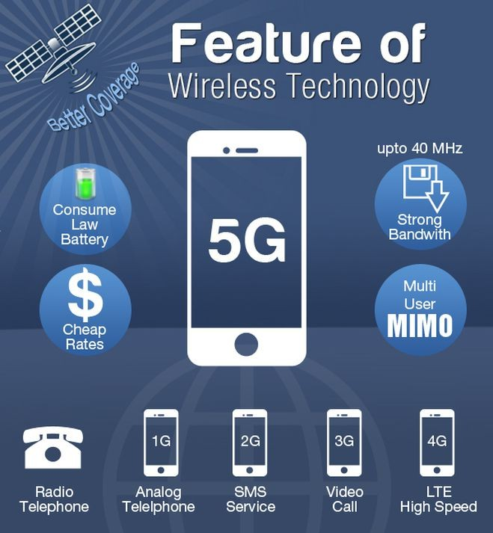
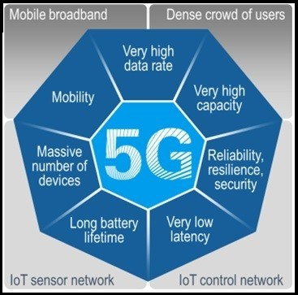
6/23/20
Fifth Generation 5G
5G will be able to performs Internet of Things (IoT) for smart home and smart city, connected cars etc.
Will be based on lower cost,
Low battery consumption
Lower latency than 4G equipment.
There will be much faster transmission rate of data to the previous versions. Thus the speed of 5G will be 1Gbit/s.
CoICT – ETE
CoICT – ETE

Slide 15
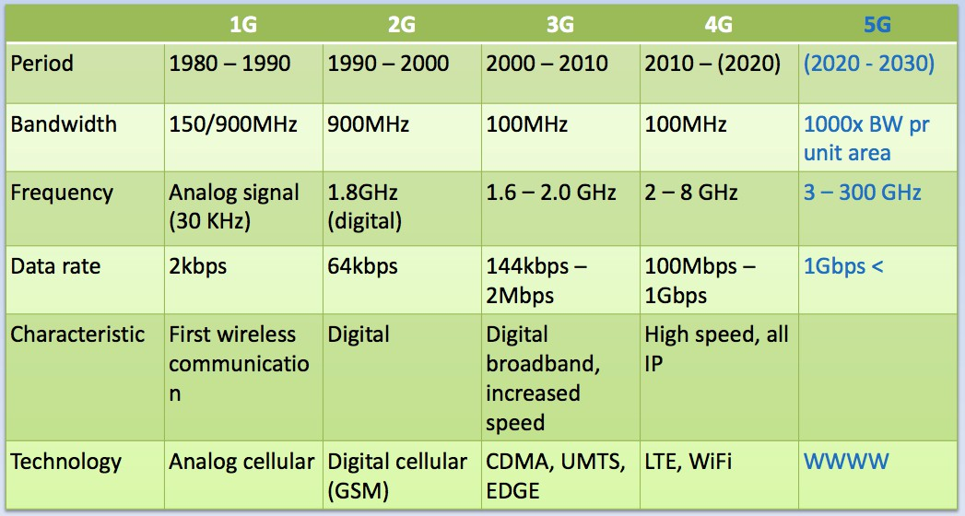
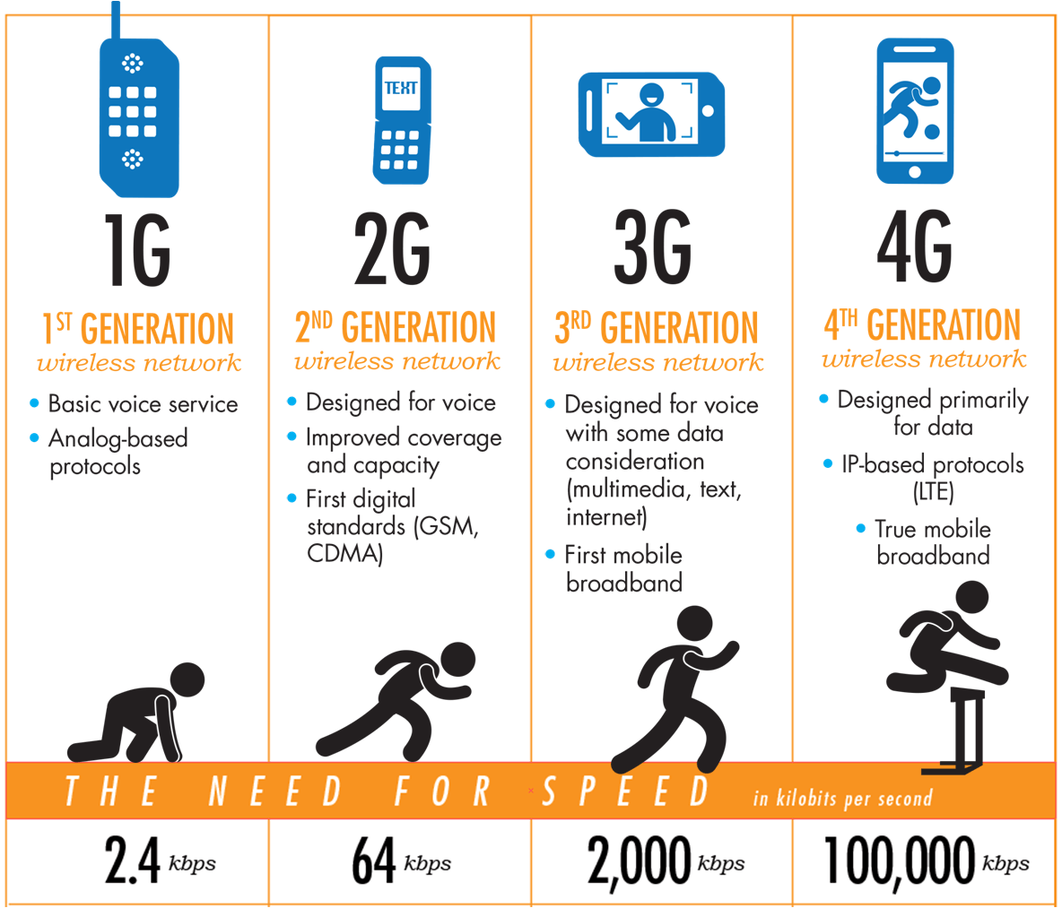
6/23/20
Summary
1G
2G
3G
4G
5G
CoICT – ETE
CoICT – ETE

Slide 16
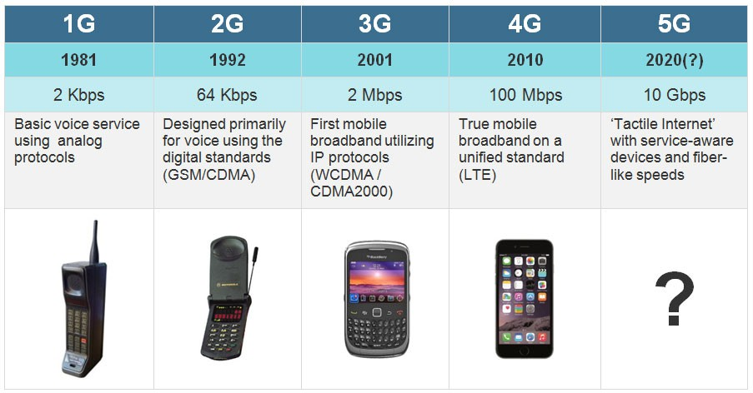
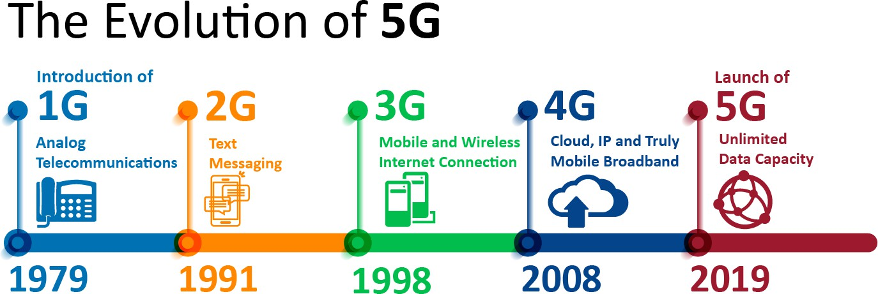
6/23/20
CoICT – ETE
T
CoICT – ETE

Slide 17
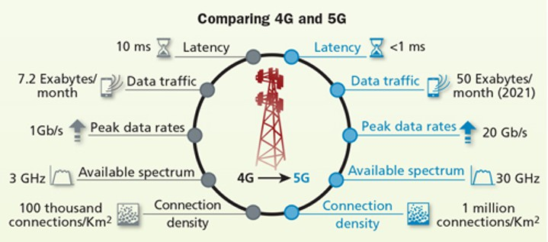
6/23/20
CoICT – ETE
Future Generations
6G:
Integrate 5G with satellite network for global coverage
Ultra fast Internet access
Smart home/cities
7G:
Space roaming
World completely wireless
CoICT – ETE

